Slide 1
FOSS MileStone 2
Anjan Debnath

Slide 2
Why Agile team fails
Comparing what one team can do vs. another is a shorthand management approach to agile at its worst. Do not do what works for another team. Do what is right for your team.
"Look over here – this team seems to be doing well, we should just copy what they are doing!"

Slide 3
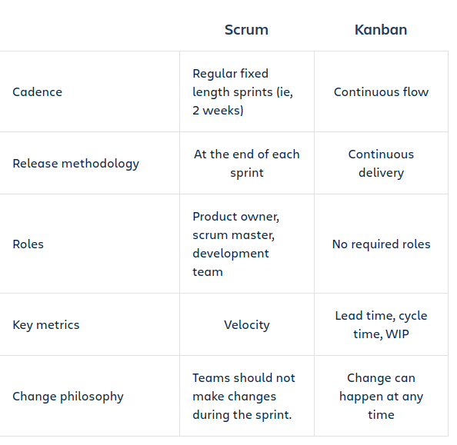
Kanban vs Scrum

Slide 4
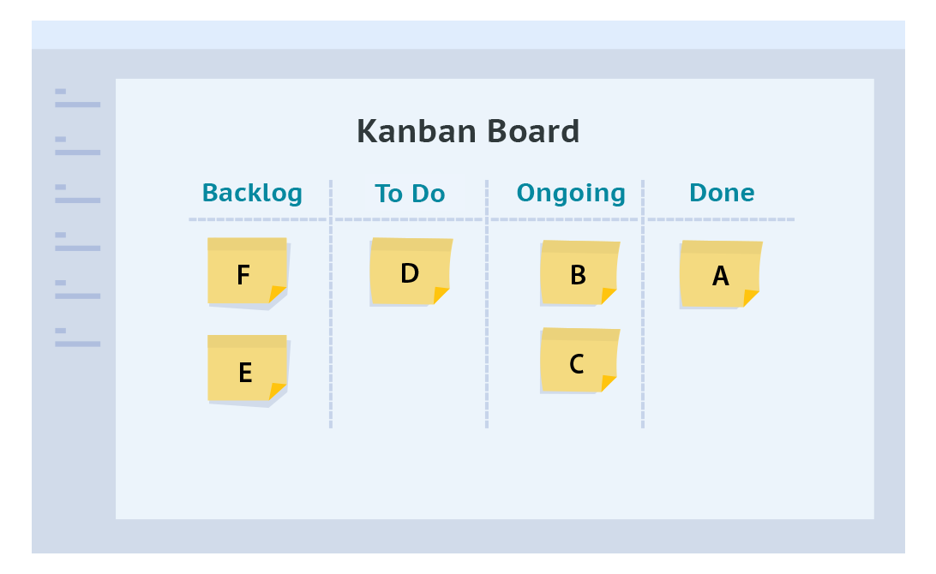
Kanban method

Slide 5
WorkFlow Development & Optimizing
Ref : https://producingoss.com/en/getting-started.html#starting-from-what-you-have
Choose a Good Name - A good name gives some idea what the project does, or at least is related in an obvious way, such that if one knows the name and knows what the project does, the name will come quickly to mind thereafter.
Have a Clear Mission Statement - Once they've found the project's home site, the next thing people will look for is a quick description or mission statement, so they can decide (within 30 seconds) whether or not they're interested in learning more. This should be prominently placed on the front page, preferably right under the project's name.
State That the Project is Free - The front page must make it unambiguously clear that the project is open source.
Features and Requirements List - There should be a brief list of the features the software supports (if something isn't completed yet, you can still list it, but put "planned" or "in progress" next to it), and the kind of computing environment required to run the software.

Slide 6
WorkFlow Development & Optimizing
Development Status - Visitors usually want to know how a project is doing.
Version Control and Bug Tracker Access - The importance of a bug tracking system lies not only in its day-to-day usefulness to developers, but in what it signifies for project observers.
Communications Channels - Visitors usually want to know how to reach the human beings involved with the project.
Developer Guidelines - If someone is considering contributing to the project, she'll look for developer guidelines.
Documentation - Documentation is essential. There needs to be something for people to read, even if it's rudimentary and incomplete.

Slide 7
Contributing guides
Ref : https://github.com/nayafia/contributing-template
From the contribution template we have added the template on Telemesh project
https://github.com/w3-engineers/telemesh/blob/feature/codeofconduct/CONTRIBUTING.md
Now we need to change the template according to our company policy or we can start writing our own contributing guides.

Slide 8
Pull Request Template
When you add a pull request template to your repository, project contributors will automatically see the template's contents in the pull request body.
To store your file in a hidden directory, type .github/, then the name of your pull request template. For example, .github/pull_request_template.md.
Ref : https://blog.axosoft.com/enhancing-pull-request-descriptions-templates/

Slide 9
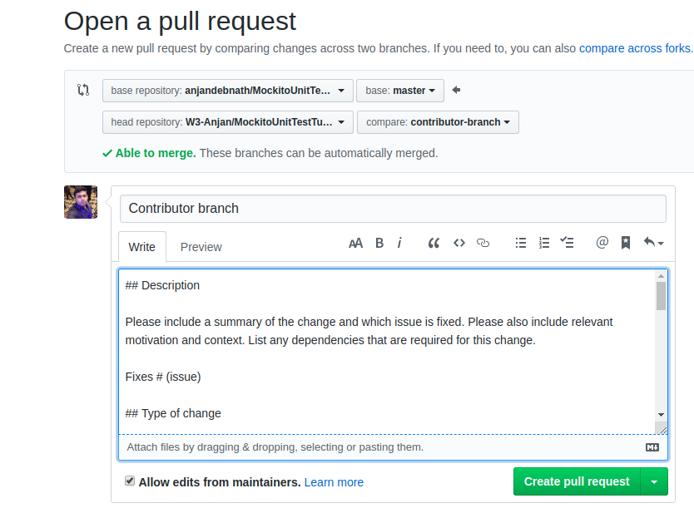

Slide 10
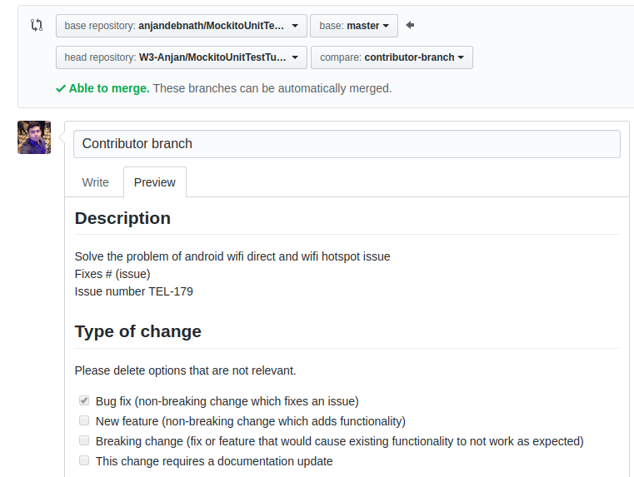

Slide 11
Write Documentation & Project board in Github
Documentation template
https://www.writethedocs.org/guide/writing/beginners-guide-to-docs/
Board
https://help.github.com/en/articles/about-project-boards

Slide 12
Github Project Board
Project boards on GitHub help you organize and prioritize your work.
Project boards are made up of issues, pull requests, and notes that are categorized as cards in columns of your choosing.
How to create a project board in github
https://codeburst.io/an-introduction-to-github-project-boards-2944e6ffbf3c

Slide 13
Create Issue Template
https://gist.github.com/Nolski/3f8ba5e4ddbd865fc181f93b47b2c23c
This template is best suited for any project.
“Choose your own adventure” is a good template
https://www.talater.com/open-source-templates/

Slide 14
Move ticket from open to inprogress
Custom stages can be used
https://help.codetree.com/en/articles/2605237-workflow-and-custom-stages
It’s not free and need to be paid

Slide 15
Configuring the Github Repository
We’re looking to solve for two things,
to move an issue along the project board based on it’s status and
to triage issues to a project board.
With the right labels, you can subscribe to the ‘labeled’ and ‘unlabeled’ events and use the payload delivered to your web-hook to add an issue to a project board and to move that issue (now a project card) along our project columns.

Slide 16
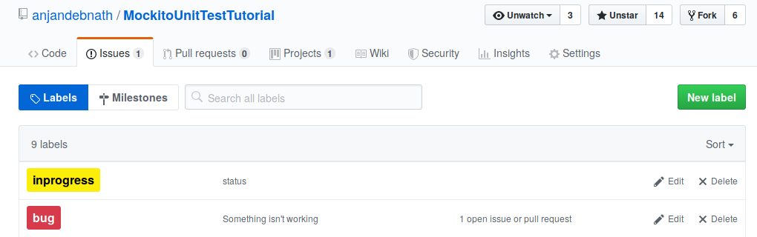
Creating a status Label
https://help.github.com/en/articles/creating-a-label

Slide 17
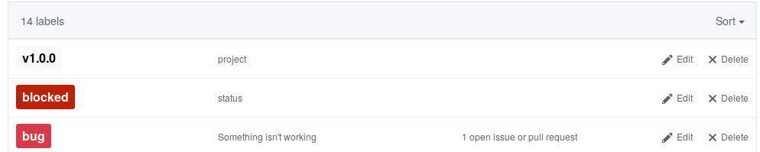
Creating a Project label
Of course your project names can be completely different just ensure that
Your project name match labels with the label description ‘project’.
Your project columns match labels with the label description ‘status’.

Slide 18
Web-hook
There’s all this communication happening via APIs these days. You look up what the API is offering and you consume it.
Think of webhooks as the siblings of API calls. It’s you saying you want to be notified when something changes instead of polling for those changes like you might do with an API.
Sometimes you tell a server what you want and sometimes it tells you what it’s doing. That’s a webhook.
https://codeburst.io/whats-a-webhook-1827b07a3ffa

Slide 19
Creating web-hook locally
To create webhook we need a payload url. This url can be a server url or for testing purpose we can use ngrok
We need to sign in to ngrok.com get the auth token.
Full steps can be found here https://ngrok.com/download
After getting registered with github we can get this link as access token
./ngrok authtoken 1QPIJfT8bqNKZXp27UCQC59wePx_74aDzqVrCzQ7FrsjkYUCt
Then running this command on cmd ./ngrok http 4567
To configure ngork : https://developer.github.com/webhooks/configuring/

Slide 20
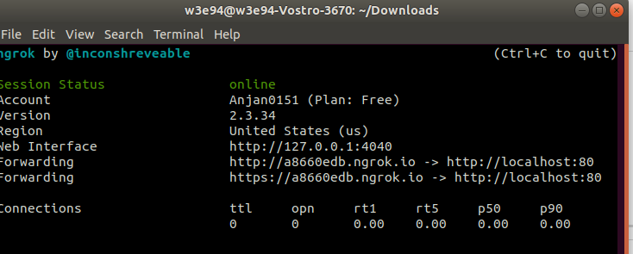
Configuring a GitHub web-hook locally
http://a8660edb.ngrok.io is the url that we need to set on Github payload url

Slide 21
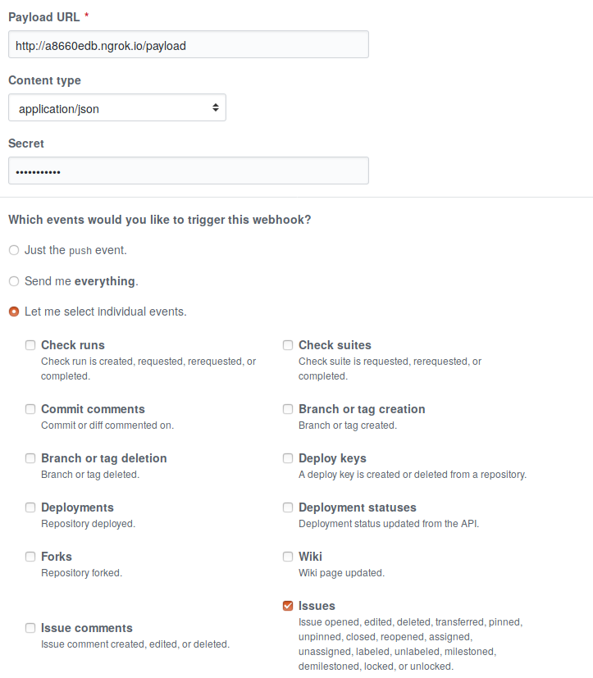
Configuring a web-hook
Connect your account
$ ./ngrok authtoken 1QPIJfT8bqNKZXp27UCQC59wePx_74aDzqVrCzQ7FrsjkYUCt
To start HTTP tunnel
$ ./ngrok http 80

Slide 22
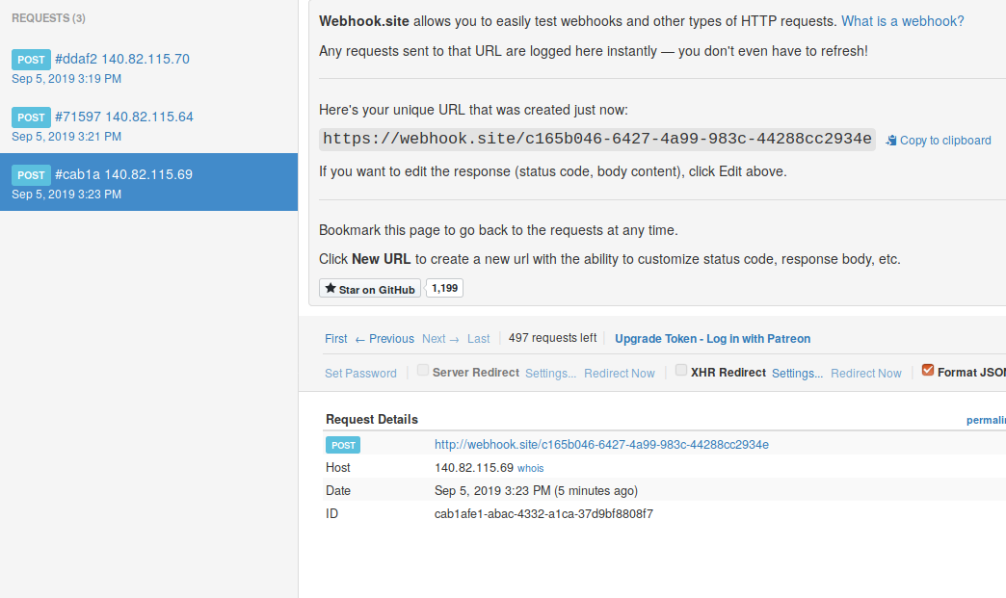
WebHook tester
We can get the payload link from WebHook tester that we can put as payload url
https://webhook.site/

Slide 23
Accesstoken Private
The last thing you need to do is to create a GitHub token. This will allow you to authenticate your requests to GitHub’s API. To get a personal token, go to your GitHub settings, create a new token giving it a memorable name, and copy the token to a secure place.
Access token : 2f21e9cb61c7c5bc3c96165163192b60dc237ac1

Slide 24
GraphQL for github
All in all we need to construct the queries on the issue and projects fields to do the following:
Find an issue by number.
Find a project by name.
Find all project columns.
Add an issue to a project column.
Move a project card to a different column.
Delete a card from a project.
With these, we’ve got everything we need to write the necessary queries and mutations for the web-hook.

Slide 25
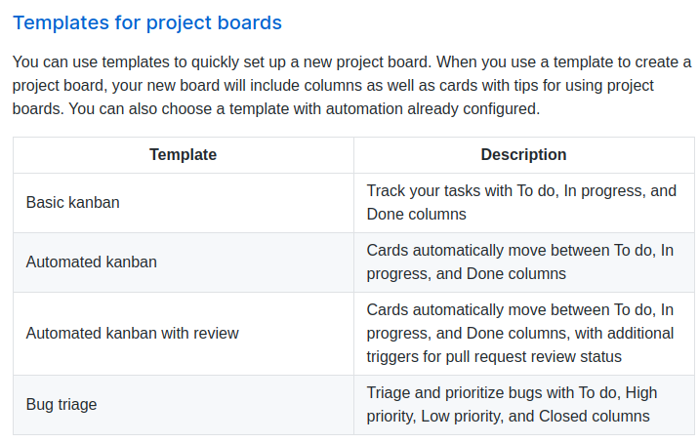
Template for Github Project boards

Slide 26
Automated Kanban on Github
Create project on github from Automated Kanban Template
Create issue and it will be in To do list
Add metadata to the issue
assignee
Label
Project
Create fix branch on the cloned repo
Fix the issue and make final commit with Fixes<issue_number>
Push the code and create PR and assign into project/board and it will be in the In progress list.
Merge the PR then it will be automatically moved to done list.

Slide 27
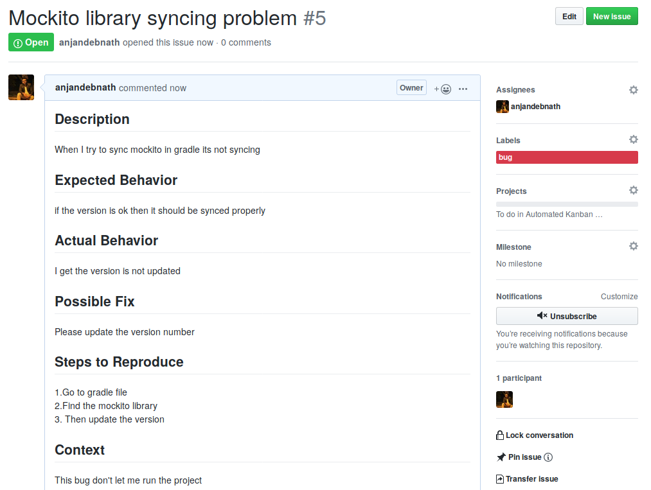
Create Issue

Slide 28
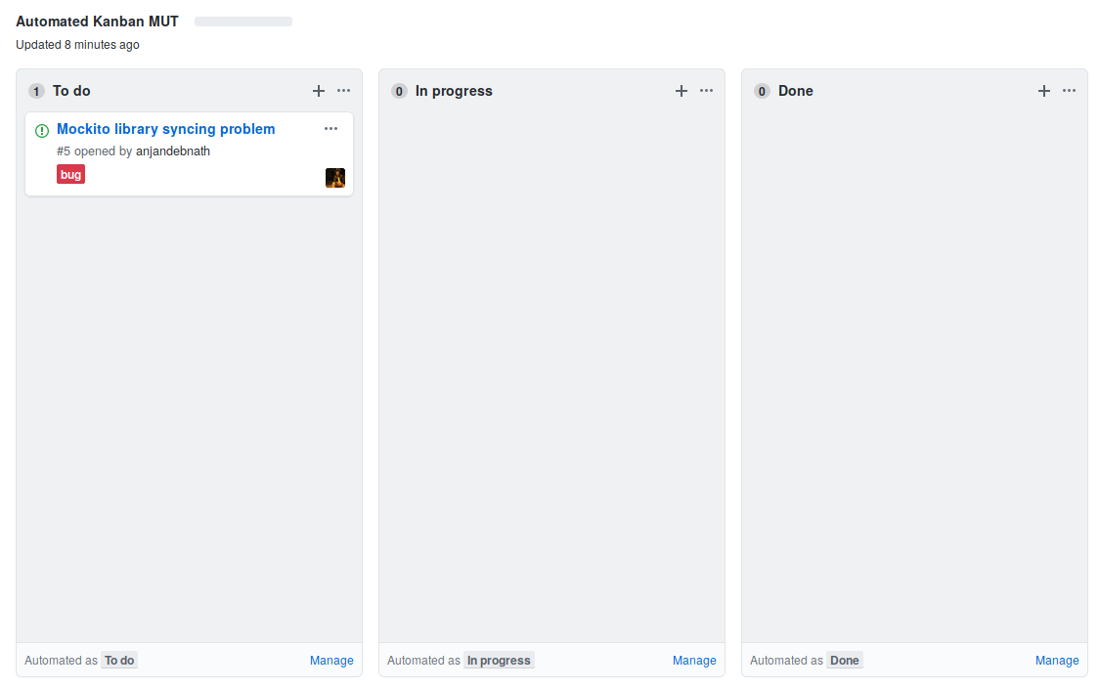

Slide 29
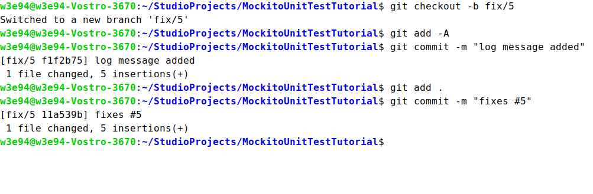
Fix & Commit
Final commit message will be in this format
Fixes <issue_number>
Fixes#5
Issue referencing advantage from Github https://help.github.com/en/articles/closing-issues-using-keywords

Slide 30
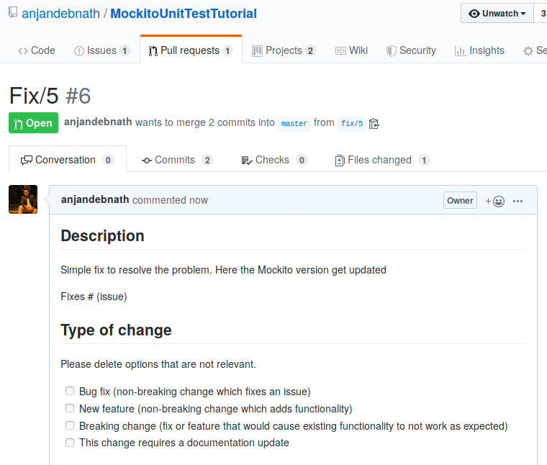
Push the code and create PR

Slide 31
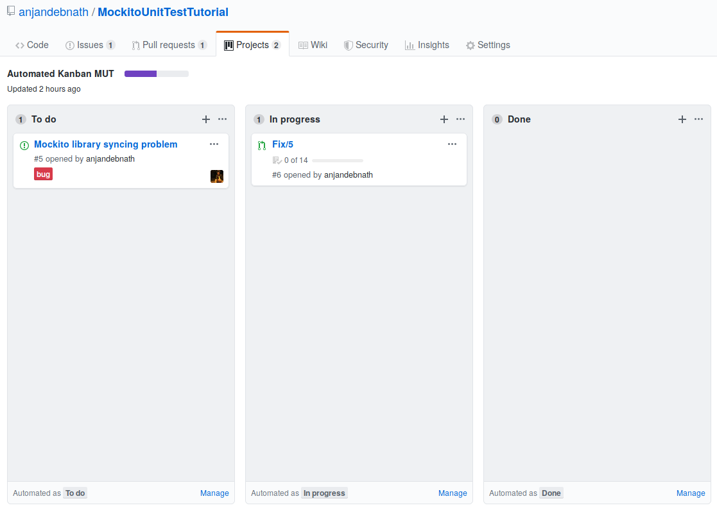
PR now in progress
According to Kanban automation rule when a PR will created and assigned to project then that PR will be in the inprogress list

Slide 32
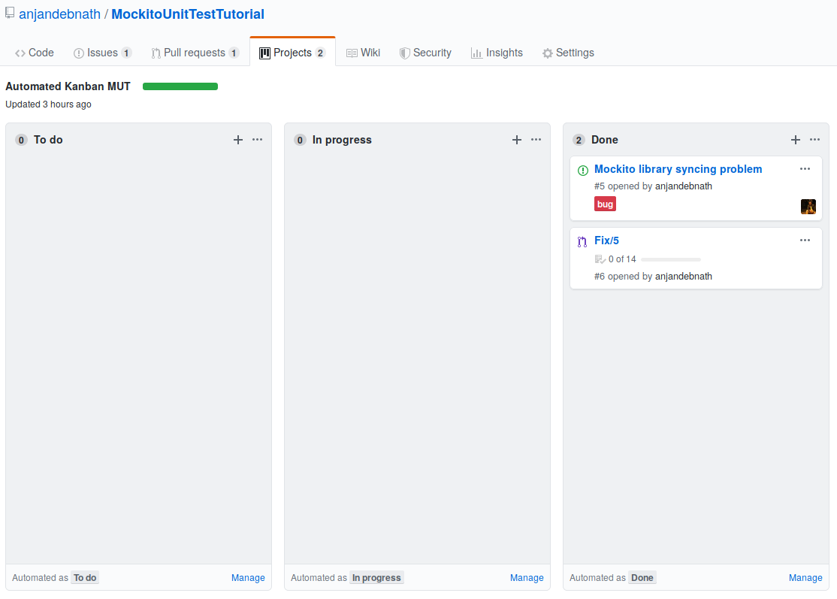
Merge PR and done
After merging the PR the issue and PR both will be in Done list

Slide 33
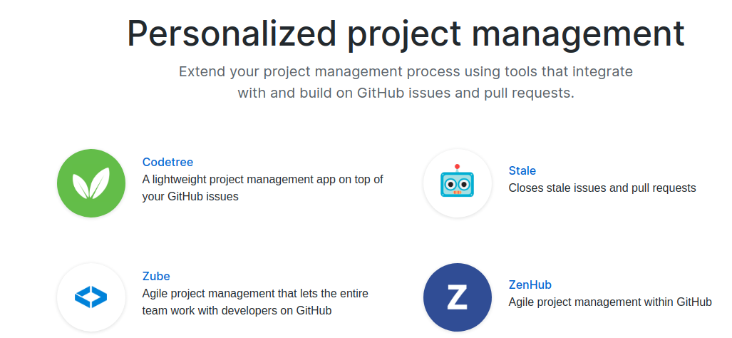
Personalized project management

